Slide 1

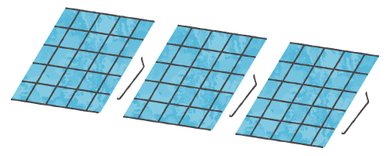
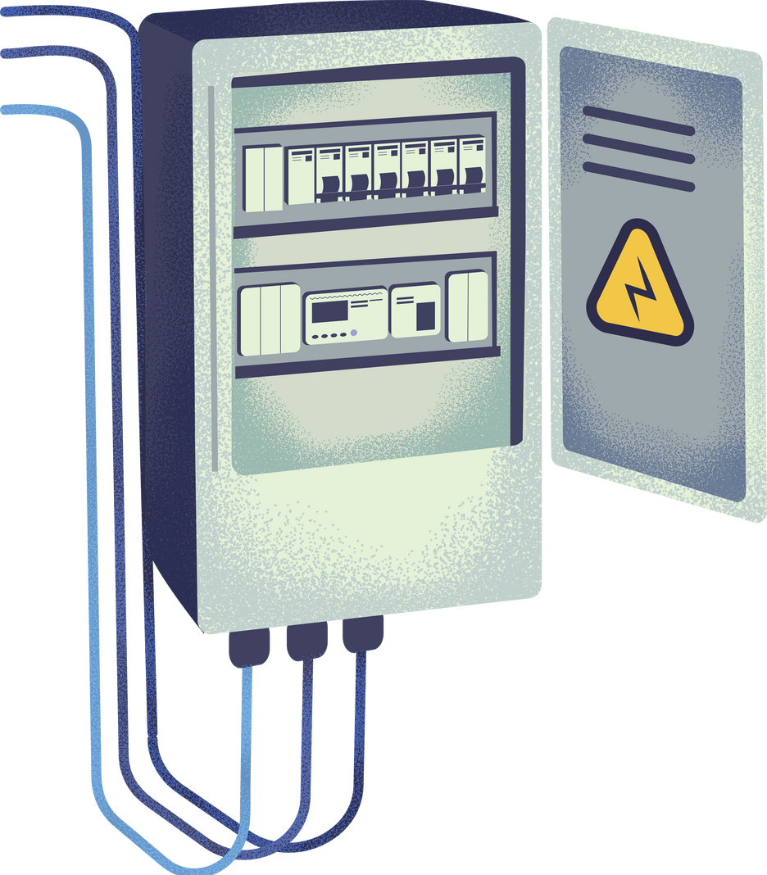




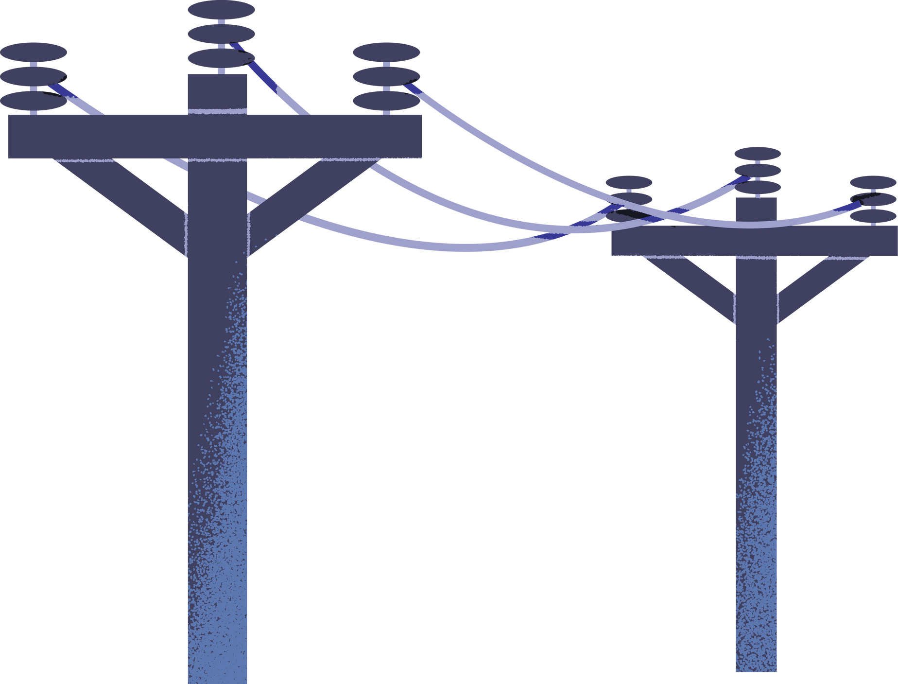
Egypt's Energy Landscape:
A Comparative Analysis

Slide 2
Our Team
Ahmed Abdelaty Gohar
Mahmoud Abdelnaby Refaat
Amr Fawzy Abdelhamed
Mahmoud Magdy Elsaeed Abdelrahman

Slide 3



Energy in Egypt

Slide 4



01
Total Generation
Comparing Electric Power Generation With Different Countries
02
Energy Mix
Comparing Energy Mix With Different Countries
03
Emissions and Efficiency
Comparing CO2 Emisssions and Energy Efficiency
04
Renewable Energy
Comparing Renewable Energies With Different Countries

Slide 5








Energy sources

Slide 6

Are all fossil-fuel grids equally dirty?

Slide 7


79% Natural Gas
Vs
11% Fuel Oil

Slide 8


11% → ~50%
Fuel Oil’s share of emissions

Slide 9

Gas ≠ Coal

Slide 10

Nuclear is coming: 10–15%

Slide 11


The Nuclear Swap
Replace Oil. Not Gas.

Slide 12

~50% CO₂ reduction
Power sector

Slide 13

Environment solved.
Does it make financial sense?

Slide 14
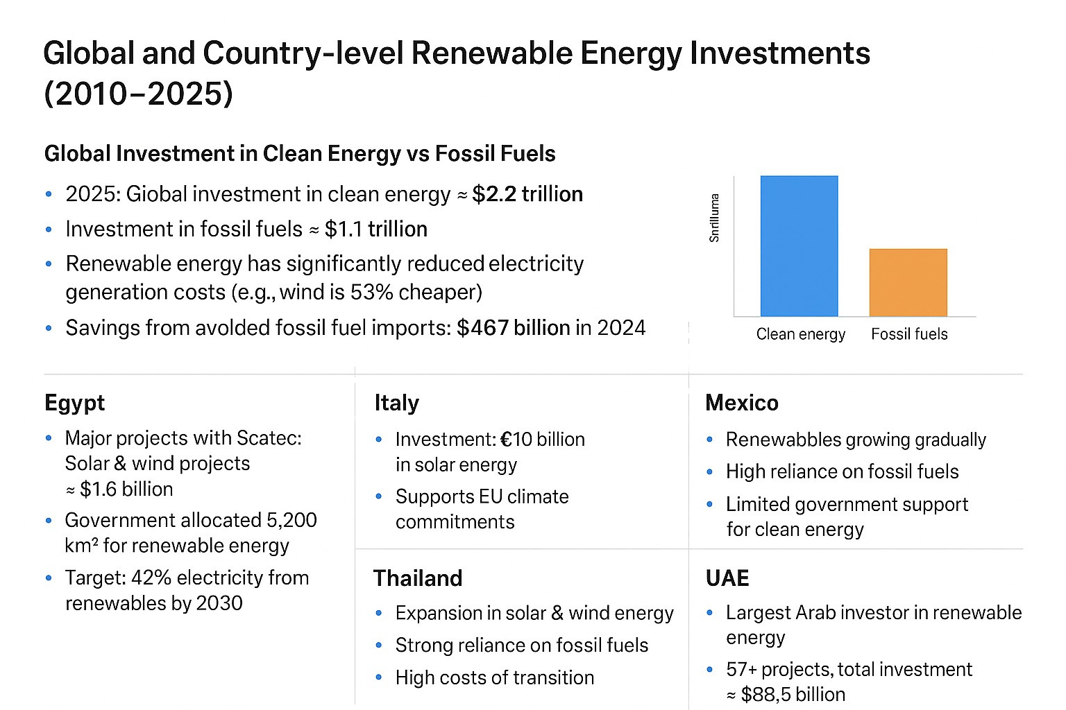

Slide 15
Thank You

